Slide 1


Slide 2


Engine Performance Monitoring Tool
Key Features
Graphical representation of Load Diagram based on ME Shop Trial Report , ME Sea Trial report and Monthly Performance Data
Shows deviations in Important Pressure and Temperature Parameters , which affects Engine Performance
Graphical representations of : 1) Engine Power Vs T/C Speed , 2) Engine Power Vs Fuel Pump Index, 3) Engine Power Vs Scavenge Air Pressure, 4) Engine Power Vs Exhaust Gas Temperature, 5) Engine Power Vs Pmax, 6) Engine Power Vs Pcomp, 7) Engine Power Vs SFOC.
An Evaluation report showing alerts and recommendations
A reminder e-mail for engines which are not in compliance with set “Rule of Performance Status ”
Import feature for Importing TE-07 & TE-12 Forms
Notes:
Discuss the why of core values- whenever there is a conflict, Core values assist in doing the right thing
Empathy- People are greatest asset.
Respect – Talk about being respectful with each other
Empowerment- Talk about how empowering everyone makes the system and processes mean more safe working conditions .
Talk about how accessible the whole management team should be. We all are a call away.

Slide 3
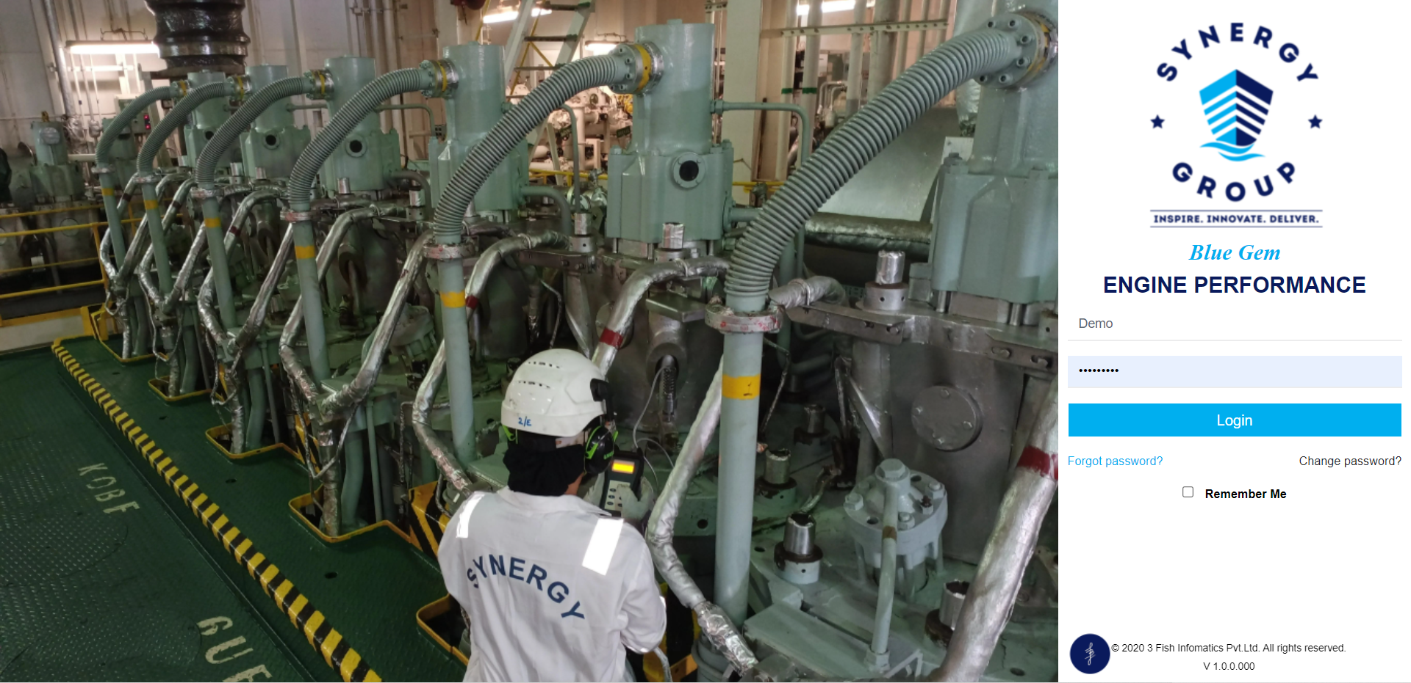
Login Screen
Notes:
Discuss the why of core values- whenever there is a conflict, Core values assist in doing the right thing
Empathy- People are greatest asset.
Respect – Talk about being respectful with each other
Empowerment- Talk about how empowering everyone makes the system and processes mean more safe working conditions .
Talk about how accessible the whole management team should be. We all are a call away.

Slide 4
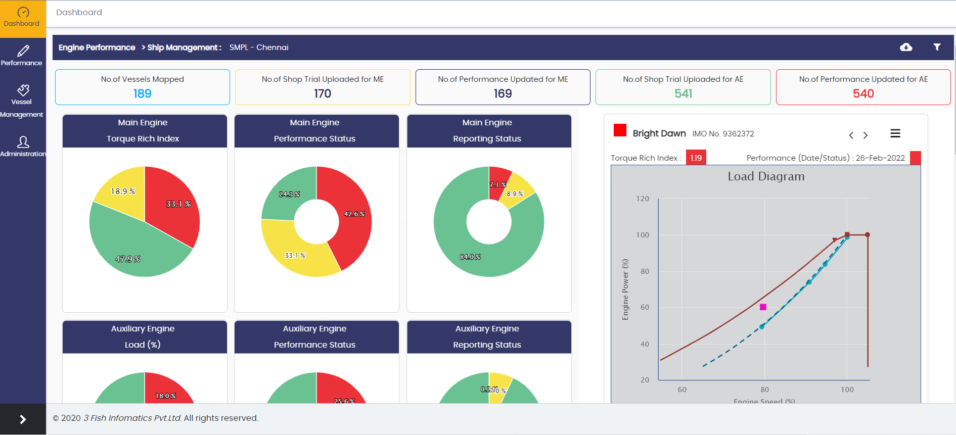
Dashboard :
Notes:
Discuss the why of core values- whenever there is a conflict, Core values assist in doing the right thing
Empathy- People are greatest asset.
Respect – Talk about being respectful with each other
Empowerment- Talk about how empowering everyone makes the system and processes mean more safe working conditions .
Talk about how accessible the whole management team should be. We all are a call away.

Slide 5
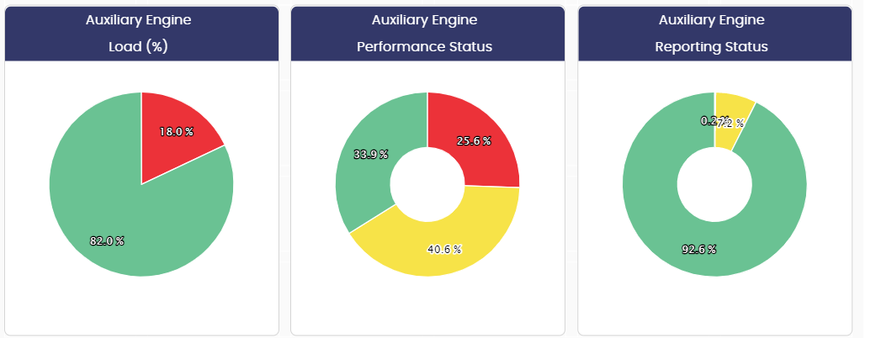
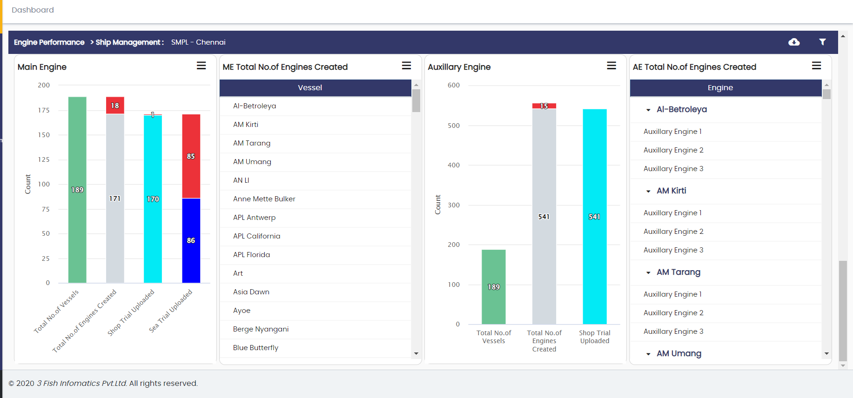
Notes:
Discuss the why of core values- whenever there is a conflict, Core values assist in doing the right thing
Empathy- People are greatest asset.
Respect – Talk about being respectful with each other
Empowerment- Talk about how empowering everyone makes the system and processes mean more safe working conditions .
Talk about how accessible the whole management team should be. We all are a call away.

Slide 6
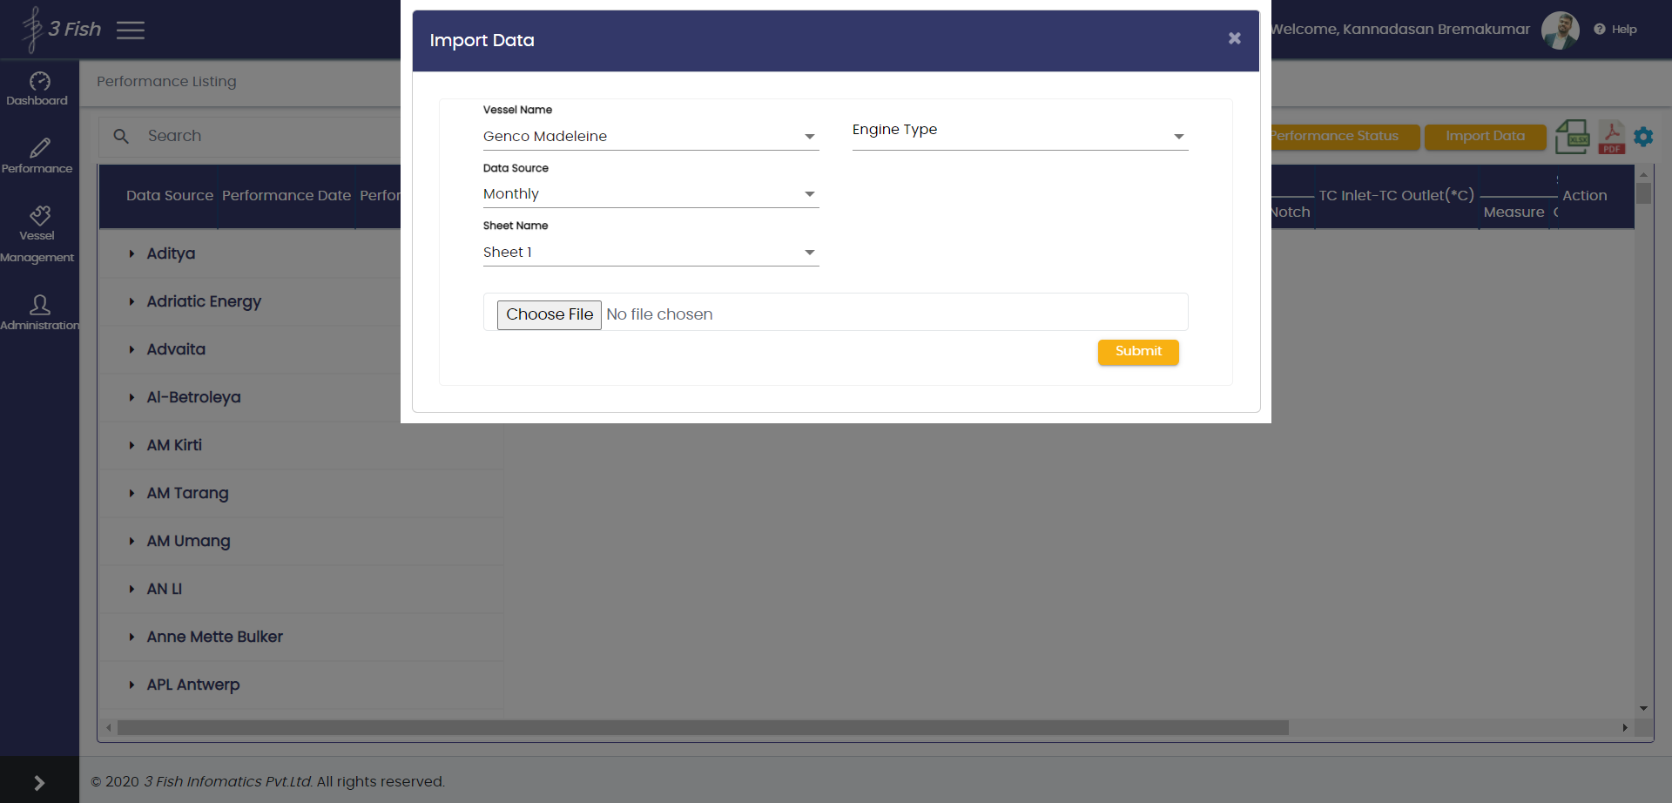
Importing a Monthly Performance Form
Notes:
Discuss the why of core values- whenever there is a conflict, Core values assist in doing the right thing
Empathy- People are greatest asset.
Respect – Talk about being respectful with each other
Empowerment- Talk about how empowering everyone makes the system and processes mean more safe working conditions .
Talk about how accessible the whole management team should be. We all are a call away.

Slide 7
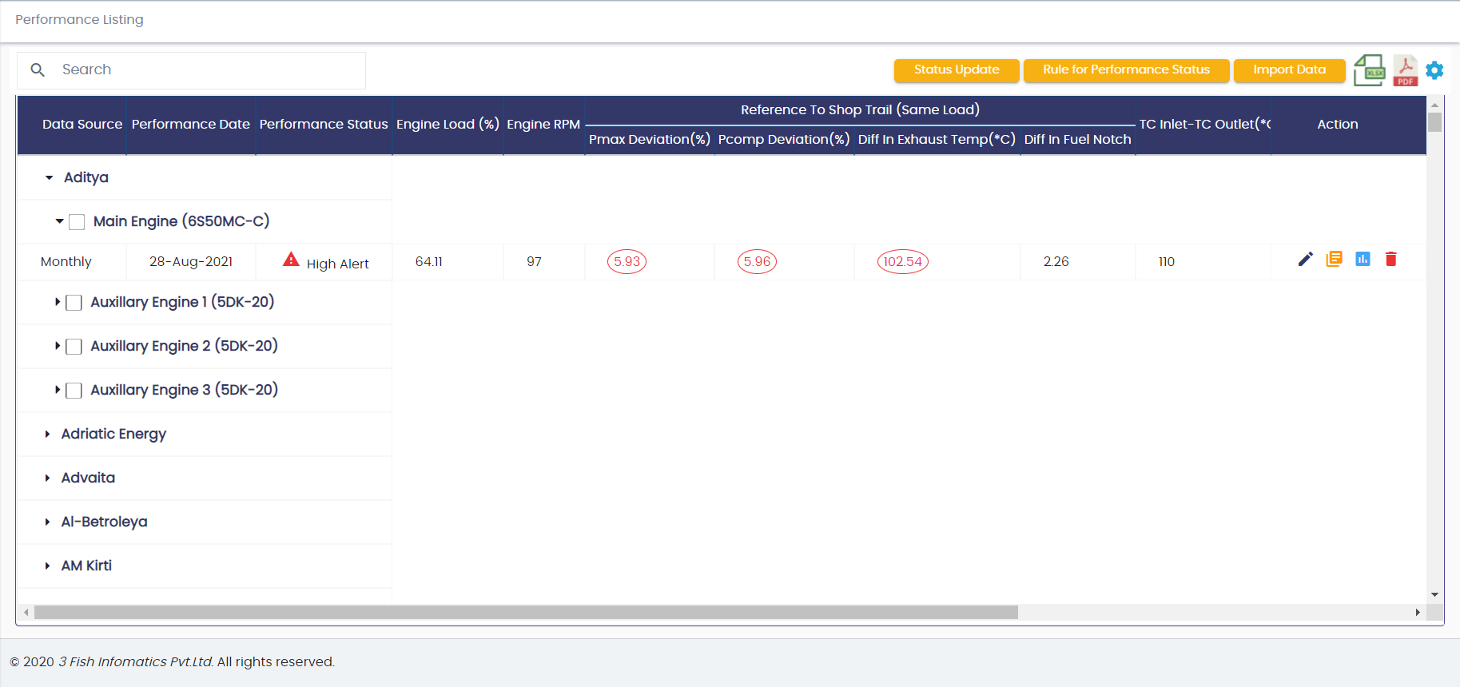
Performance Listing Screen
Notes:
Discuss the why of core values- whenever there is a conflict, Core values assist in doing the right thing
Empathy- People are greatest asset.
Respect – Talk about being respectful with each other
Empowerment- Talk about how empowering everyone makes the system and processes mean more safe working conditions .
Talk about how accessible the whole management team should be. We all are a call away.

Slide 8
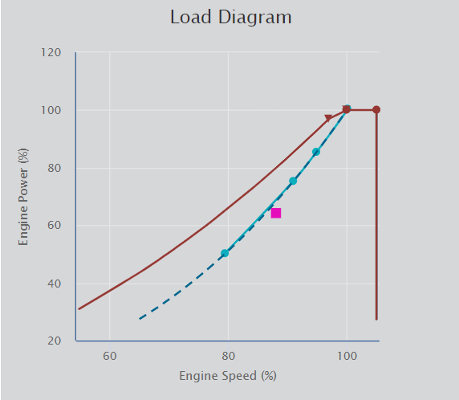
Performance Listing Screen
Load Diagram Engine Speed Vs Engine Power with
Propeller Curve
Shop Trial Curve
Sea Trial Curve
Torque/Speed Limit Curve
Overload Line
Performance Value Plot
Notes:
Discuss the why of core values- whenever there is a conflict, Core values assist in doing the right thing
Empathy- People are greatest asset.
Respect – Talk about being respectful with each other
Empowerment- Talk about how empowering everyone makes the system and processes mean more safe working conditions .
Talk about how accessible the whole management team should be. We all are a call away.

Slide 9
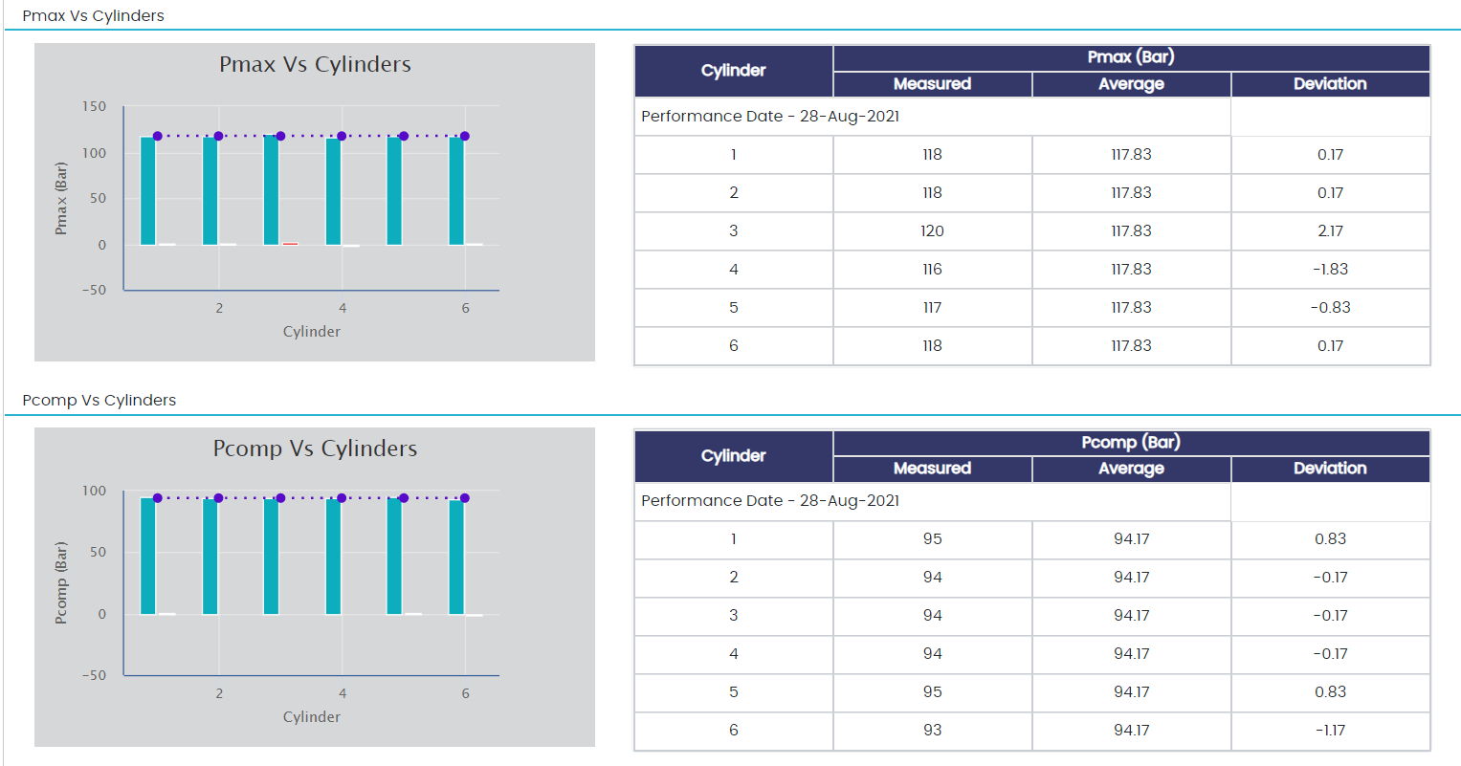
Charts :
Charts with Unit wise Data of Measured , Average and Deviation values for easy evaluation
Notes:
Discuss the why of core values- whenever there is a conflict, Core values assist in doing the right thing
Empathy- People are greatest asset.
Respect – Talk about being respectful with each other
Empowerment- Talk about how empowering everyone makes the system and processes mean more safe working conditions .
Talk about how accessible the whole management team should be. We all are a call away.

Slide 10
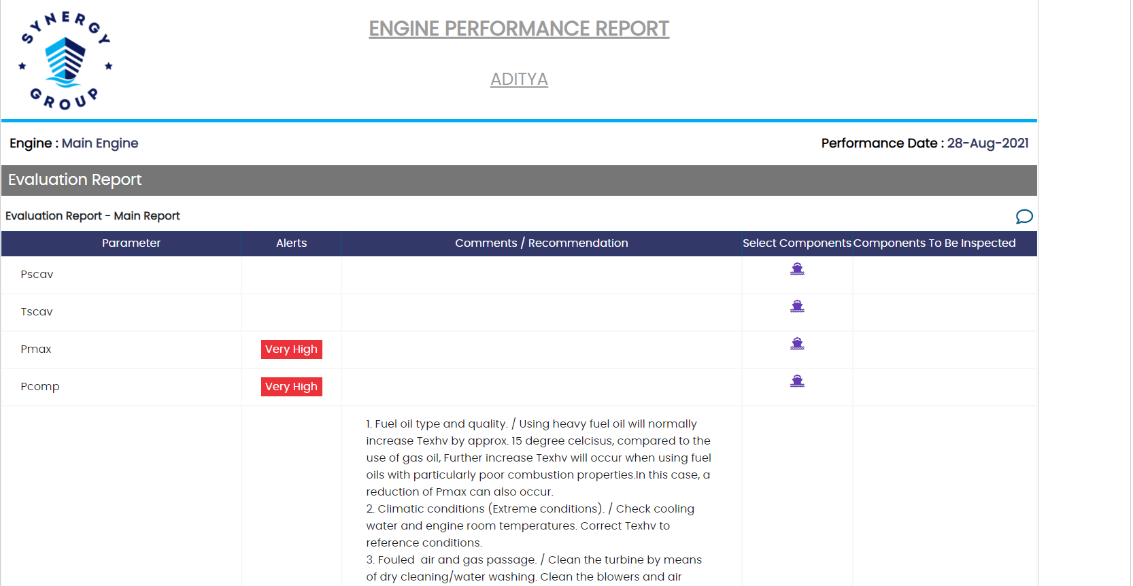
ENGINE PERFORMANCE REPORT
Notes:
Discuss the why of core values- whenever there is a conflict, Core values assist in doing the right thing
Empathy- People are greatest asset.
Respect – Talk about being respectful with each other
Empowerment- Talk about how empowering everyone makes the system and processes mean more safe working conditions .
Talk about how accessible the whole management team should be. We all are a call away.

Slide 11
Thank You !!
Notes:
Discuss the why of core values- whenever there is a conflict, Core values assist in doing the right thing
Empathy- People are greatest asset.
Respect – Talk about being respectful with each other
Empowerment- Talk about how empowering everyone makes the system and processes mean more safe working conditions .
Talk about how accessible the whole management team should be. We all are a call away.

